Slide 1

Department of ECE
GE19612 - Professional Readiness for Innovation, Employability and Entrepreneurship (Mini Project)
2023-24- Even
III Year ECE C section
Zeroth Review – 14.02.2024

Slide 2
Advanced Mobile Seismic Monitoring System
Batch Members :
Ritvik Prasad M 210801159
Nityasri Kumar P N 210801127
Tharun 210801701
Supervisor:
Dr. M. Sathish
^{Associate Professor, ECE}

Slide 3
OUTLINE
Abstract
Objective
Literature Survey
Summary of Literature
Proposed System & Novelty
Block Diagram
Hardware/Software requirements
References

Slide 4
Abstract
Advanced Mobile Seismic Monitoring System integrates deep learning with portable sensors for real-time seismic analysis. It uses a Recurrent Neural Network architecture for real time data analysis and processing which collects data from acclerometer and alerts on 2.4GHz spectrum in case of any anomaly. It empowers rapid event detection, aiding researchers and emergency responders in risk mitigation and disaster management.

Slide 5
Objective
The objective of the Advanced Mobile Seismic Monitoring System is to develop a portable solution that integrates deep learning algorithms with seismic sensors for real-time analysis of seismic activity. This system aims to empower rapid detection and prediction of seismic events, enhancing situational awareness for researchers, emergency responders mainly focussing on disaster management. It has an optimum range of approximately 200 acres, which ensures a comprehensive coverage of area.

Slide 6
Literature Survey
TITLE | YEAR | AUTHOR | TECHNIQUE
Volcano Seismic Signals Classification | 2018 | Manuel Titos | Neural Networks Link
Earthquake Detection | 2023 | Yongzhi Wang | Stack Normalized Neural Networks Link

Slide 7
Summary of Literature
Authors from Jilin University and the University of Management and Technology explore seismic monitoring system development, likely focusing on instrumentation and electrical engineering aspects.
Meanwhile, research published by Manuel Titos introduces the application of recurrent neural networks (RNN), long short-term memory (LSTM), and gated recurrent unit (GRU) models for detecting and classifying continuous volcano-seismic signals. Their study demonstrates high accuracy in real-time monitoring of volcanic activity, showcasing the potential of deep learning in seismic event analysis.

Slide 8
Proposed System
The proposed system integrates hardware components, including the Raspberry Pi 5, MPU-6050 accelerometer module, and 2.4GHz antenna to create a seismic monitoring solution.
The Raspberry Pi 5 serves as the central processing unit, providing computational power and connectivity for data analysis and transmission. Its compact size and low power consumption make it ideal for deployment in portable monitoring systems. The MPU-6050 accelerometer module, the system can accurately detect and measure seismic vibrations in multiple axes.
The 2.4GHz antenna facilitates wireless communication between monitoring nodes, enabling real-time data transmission and remote monitoring capabilities upto an optimum range of approximately 200 acres .

Slide 9
Novelty in Proposed System
The proposed system introduces advancements in seismic monitoring by integrating deep learning techniques with portable sensors. This innovative approach enables real-time analysis of seismic activity with high accuracy and efficiency, empowering rapid detection and prediction of events. Additionally, the system's portability as the system uses a raspberry pi 5, and adaptability make it uniquely suited for on-the-go monitoring, enhancing situational awareness and enabling proactive risk mitigation efforts, particularly in disaster management scenarios.

Slide 10
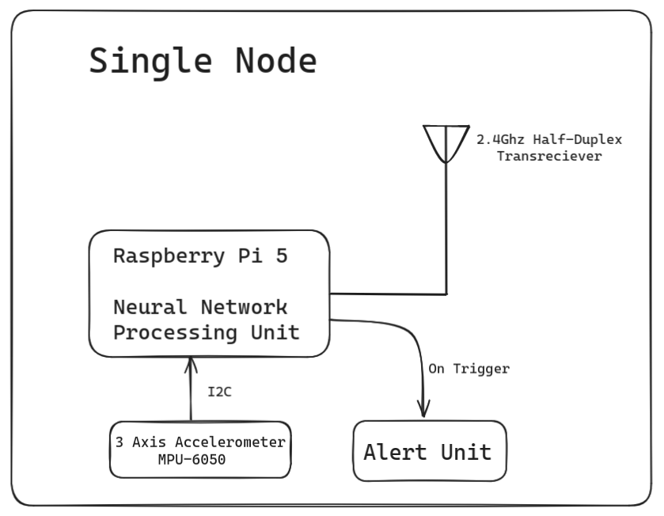
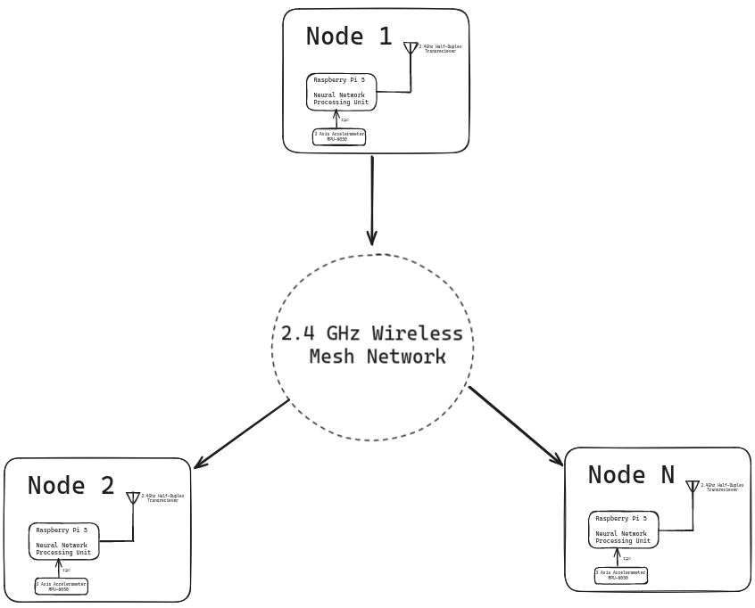
Block Diagram

Slide 11
Hardware/Software Requirements
Hardware Requirement
^{Raspberry pi 5}
2.4GHz Half Duplex Transreciever
^{3-axis Accelerometer}
Software Requirement
^{Linux Environment (server)}

Slide 12
References
https://www.mdpi.com/2076-3417/13/14/8121
https://ieeexplore.ieee.org/abstract/document/8481708

